Slide 1

Power BI Desktop
Create rich, interactive reports with Power BI

Slide 2
Power BI dashboard
An illustrative way of presenting data to stakeholders.
Used to identify key insights
Some used for information only; other used for making critical decision.
The best ones are interactive.
Features on the left side of Dashboard:
Reports: for designing and building our dashboard.
Data: importing our source data to, and it is where we can also make modification and manipulations if we like to our data.
Model: advance feature which can help manage multiple data sources.

Slide 3
Key ingredients to produce high quality dashboard
Aims : Student productivity, reduce cost, Improve quality
Visualization Design: bar chart, Pie chart, waterfall chart.
Data: collect data, external resource?

Slide 4
Connecting with data
Home / Get Data / more : look how many data sources we can have.
Home / Get Data / Excel Workbook / Red30 Tech Online Sales.xlsx / click table 1 / Load
Click on Data (on the left menu) to see the data.
Save your work by: file/ save as

Slide 5
Checking data quality : Data integrity:
Data structure: neatly organise as rows and columns
Data gaps: check blank cells and rows
Consistency: for example, when click on order type we have just two Retails and wholesale. Not Retails , Whole sale and wholesale.

Slide 6
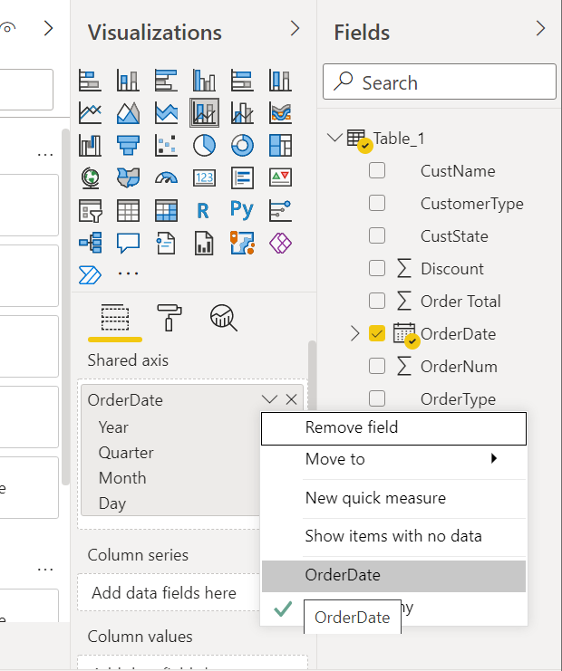
Preparing your dashboard layout
Create Title
Insert / textbox / give a title to your dashboard : Red 30 sales Report
Chart selection
Select appropriate chart from visualization section. For example, line chart
NOTE: insert/ New Visual / select line chart from visualization section.
Drag order date from Fields and drop it to axis. / click on OrderDate down
arrow and select OrderDate.
Drag Order total from Fields and drop it to values.
Add another chart (insert/ New Visual / select Waterfall chart from visualization section.) we can use waterfall chart to display aggregate sales data.

Slide 7
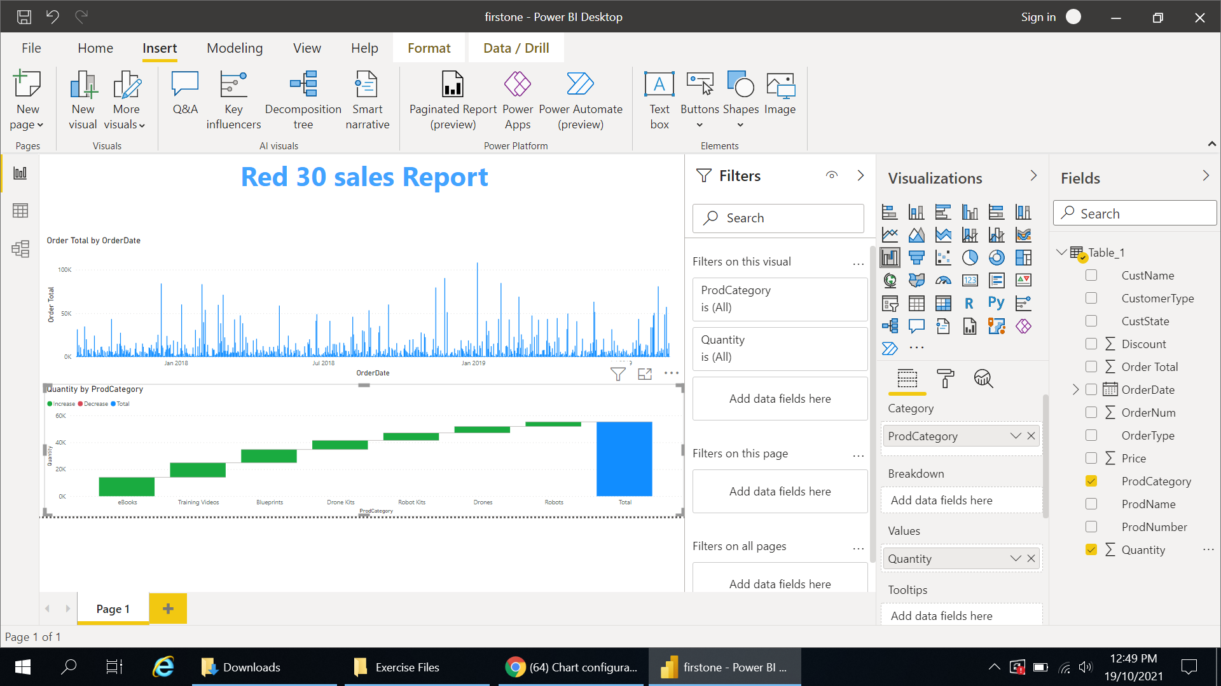
Drag product category from Fields and drop it to category and Drag quantity from Fields and drop it to values.

Slide 8
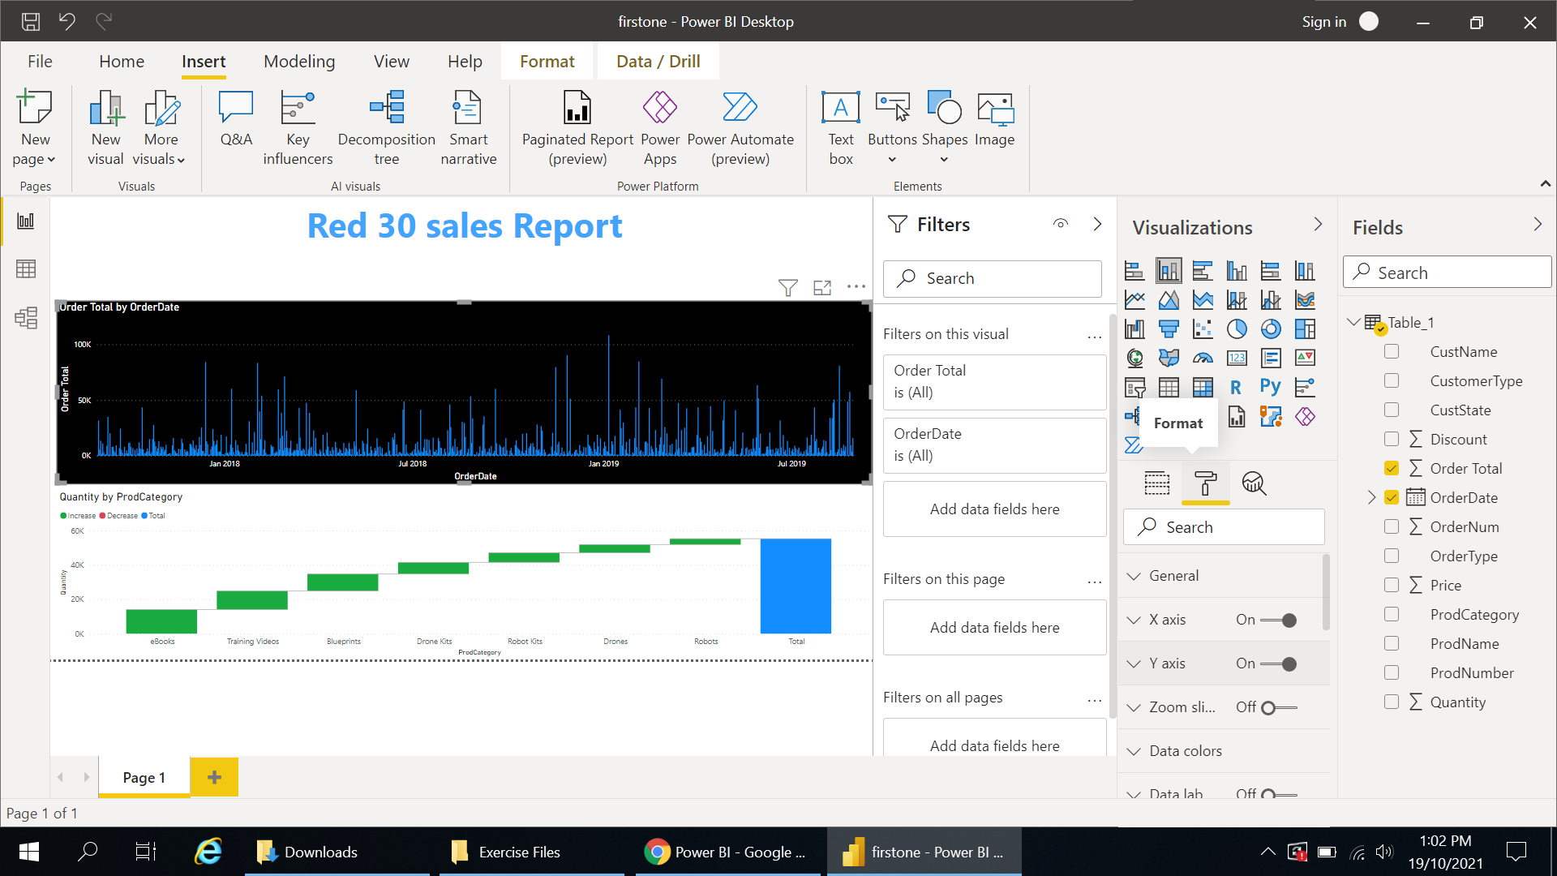
Chart configuration
Select line chart / select format (paint roll icon) / change the background color to Black.
Change the x-axis, y-axis and title to white color.

Slide 9
Dashboard filters
Filters on this visual is just related to the chart that already selected, but filter on this page is related to all charts in this page (click on empty place to get the filter on this page).
Drag CustState from Fields and drop it to filter on this page.
Select just one state for example California and see the results.

Slide 10
Second dashboard: Prep to combine multiple tables Note: data is from Gapminder.org
Open CountryPops.xslx via get data on Power BI, then select these tables: Africa, Antractia, Asia, Europe, North America, Oceania, South america tabels.
Begin with Africa: select Africa / home / transform data
Remove flag and status column: right click on cloumn / remove
Send key cloumn to the beginning : right click on cloumn / move / to the beginning
Add new column: add column tab / custom column / change the name to Continent /custome column formula is ="Africa" / ok
Do the same for all other Antractia, Asia, Europe, North America, Oceania, South america, then save this PBIX file as Countries.pbix.

Slide 11
Append data to a query
Right click on Africa table/ duplicate / and change the Africa (2) table to All Countries
Click on All Countries table / home tab / combine / append query / table to append: Antractia /ok . if you choose three or more tables you can choose all one time.
Save your work

Slide 12
Add an index column
You can see value in the Key column is repeated several times. For example, 1, 2, and 3 are repaeted more than one time for the Key column.
On the Power Query editor select all Countries / remove the Key column.
Add column tab / index column / from 1 / move the new column to the beginning / rename it to ID.
Save your work.

Slide 13
Clean up data
Open GrowthRates.xlsx / select population by country and population Growth rate /load
Home tab/ transform data / select population by country / select date column / date type / date / add new step
Select population Growth rate / select polulation growth rate column / data type / decimal number / add new step / you can see some errors. The errors is for minus numbers. You can see it is not minus sign it is hyphen.
Delete change type 1 / select one of the minus cells / replace value / _ with - / now change the data type / decimal number .

Slide 14
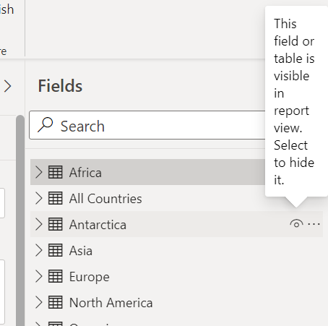
Relate tables in your model
Click on Model (left side of Power BI dashboard) / delete all relationships
Create new relationship: relate population by country to all countries based on name of the country. Drag country from population by country and drop it to name on all countries. / if you right click on relationship, you can see the properties.
Do the same for all countries and population Growth rate.
You can hide some quries as you wish. Just click on below sign.

Slide 15
Merge data
Home tab / transform data / select all countries table / combine / merge quries / merge quries as new / choose population by country / choose name field for all countries and country for population by country / you can select which join you like; I choose default one which is left outer. / ok / click on population by country column and check which columns do you want to expand. I choose population, date and % of world population. / ok
combine / merge quries / merge quries / choose population Growth rate/ choose name field for all countries and country for population Growth rate / ok / click on population Growth rate and select population Growth rate (%). / change the Merge 1 name to the meaning full name like all countries and population data

Slide 16
Use the Power BI Desktop Report view
Click on Report (left side menu). From all countries and population data choose continent and population by country.population from Fields section.
Select bar chart from visualization and choose name and population by country.% of world population.
Select Matrix from visualization and choose name, population by country.% of world population and population by country.population
Apply data bar to population by country.population : fields tab / values: click on population by country.% of world population / conditional formating / data bar / change anything you like / ok

